Slide 1


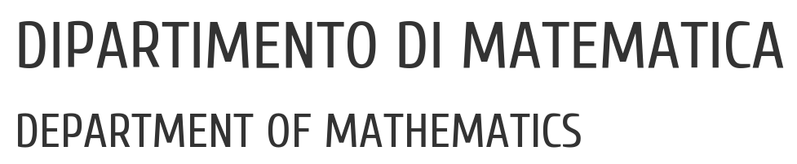

UNIVERSITY OF PADUA
UNIVERSITà DEGLI STUDI DI PADOVA
TCP ATTACKS LAB
Ethical Hacking course
MSc Cybersecurity
October 14th, 2026
Emanuele Artusi, Filippo Bellon, Jacopo Giubilato, Alessandro Vulcu

Slide 2


Professional Security Corporation
TCP ATTACKS LAB
Ethical Hacking course
MSc ICT for Internet and Multimedia
October 14th, 2026
Emanuele Artusi, Filippo Bellon, Jacopo Giubilato, Alessandro Vulcu

Slide 3
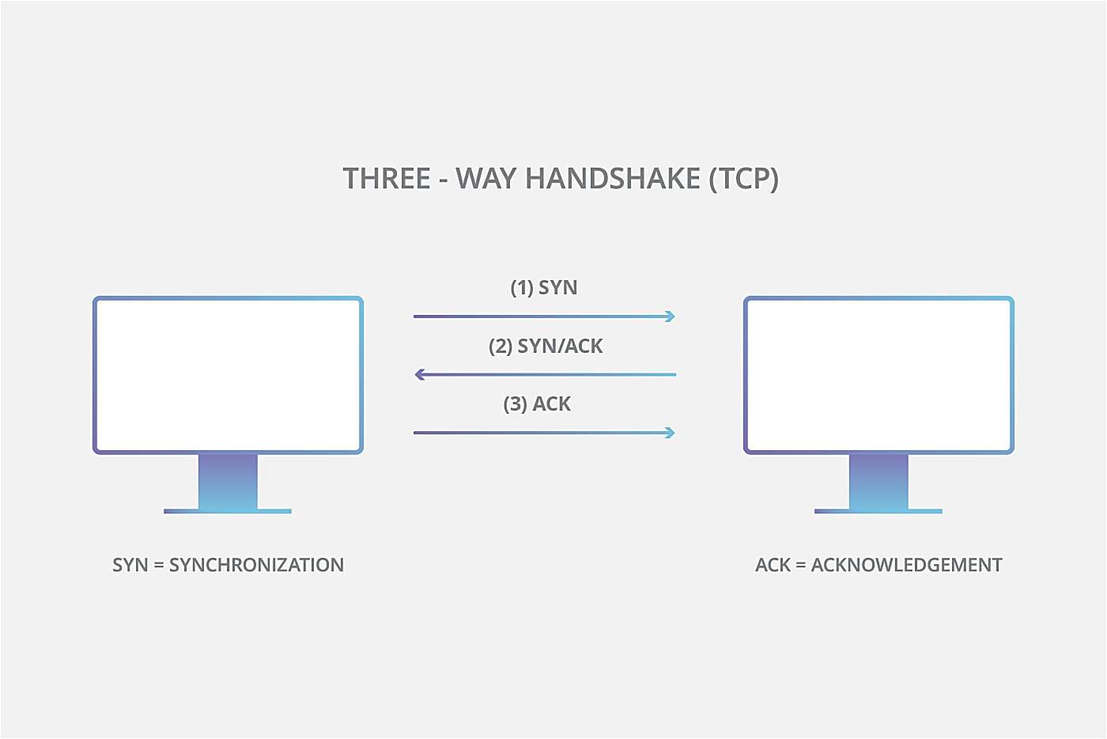
What is TCP
Professional Security Corporation
Notes:
Explaination: TCP is a set of rules that lets 2 applications exchange data reliably and in the correct order over a network. Includes also error recovery.
It works by a 3-way handshake between client and server:
- SYN: I want to connect, here is my starting seq number
SYN/ACK: I received your request, here is my starting sequence number
ACK: received your response
A RST packet is sent by the client to determine the existing TCP Session, used for error reporting

Slide 4
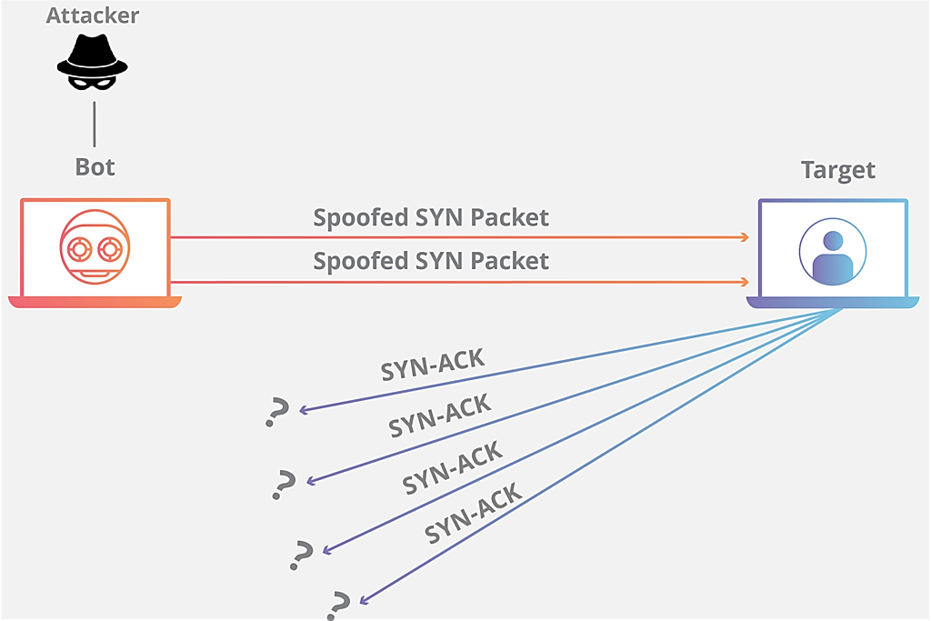
SYN flood
Professional Security Corporation
Notes:
SYN flood: An attacker sends many TCP SYN requests, which begin the SYN → SYN-ACK → ACK handshake, but never completes it.
The server accumulates half-open connections, potentially exhausting resources and blocking legitimate clients.

Slide 5
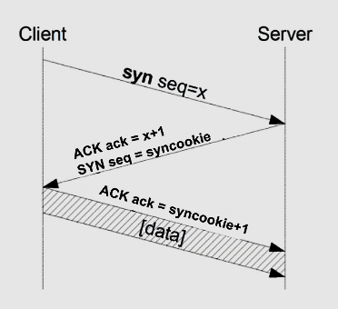
SYN cookie
Professional Security Corporation
Notes:
SYN cookie: A defense that will kick in if the machine detects that it is under the SYN flooding attack. When a valid final ACK arrives, the server validates the cookie and creates the connection. This reduces resource exhaustion, but doesn’t prevent an attack from saturating network bandwidth.
The sequence number of the server is a calculated cookie. If the client replies correctly, the server checks if the syncookie is correct by subtracting 1. if it's valid, creates the connection.
By default, in the VM this was disabled

Slide 6
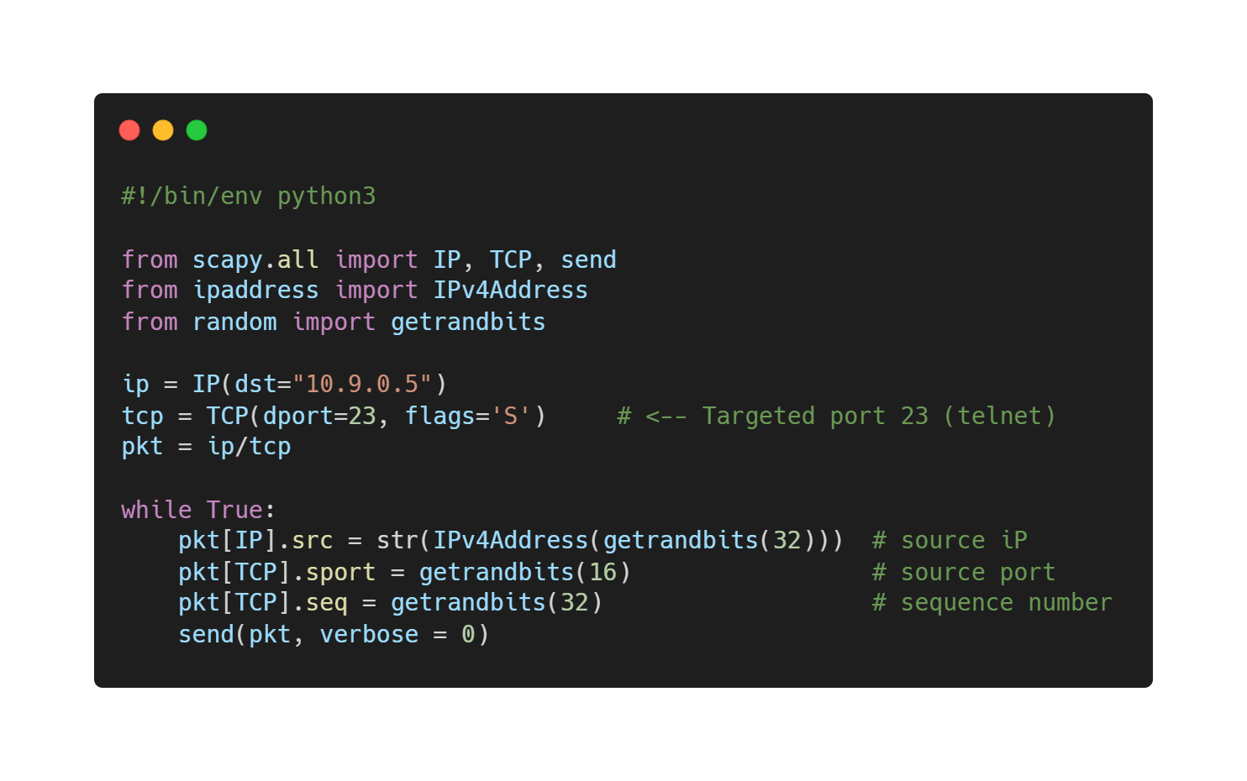
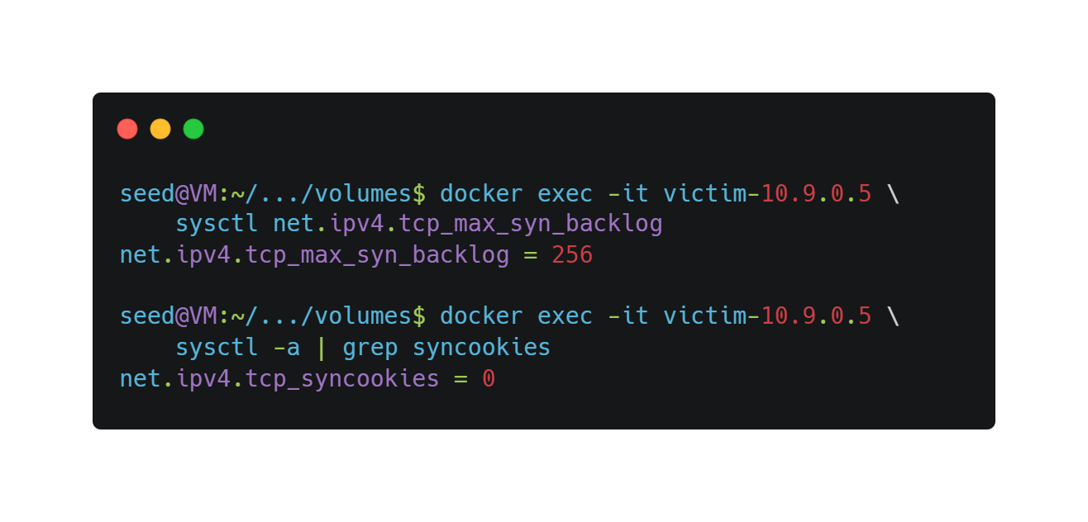
Task 1.1: Python SYN flood
Professional Security Corporation
Complete the Python draft given
Target 10.9.0.5:23
Check SYN backlog
SYN cookies disabled
Notes:
CONTENUTO:
Codice python per syn flooding con spiegazione breve
Mostrare coda e syn cookie non attivi

Slide 7
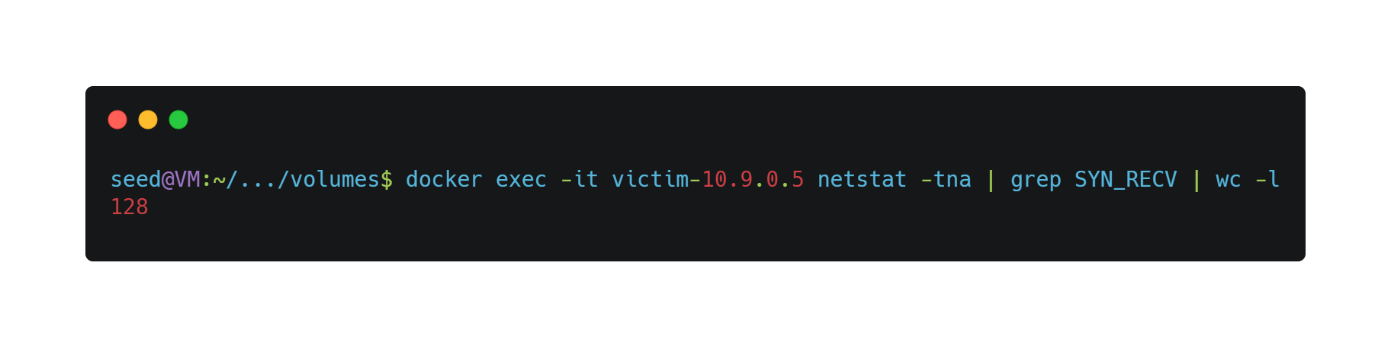
Task 1.1: Python results
Professional Security Corporation
1 instance: Telnet still connects
3+ instances: Telnet blocked
Prior clients may use reserved slots (kernel mitigation)
Notes:
CONTENUTO:
Controllo occupazione coda
1 istanza di flooding PERMETTE connessione con telnet, NO se ne avviamo almeno 3 (no kernel mitigation piena) --> ! (possibile aggiunta foto Wireshark)
Kernel mitigation utile per connettere connessioni precedenti (da dire anche se non testato ?)

Slide 8
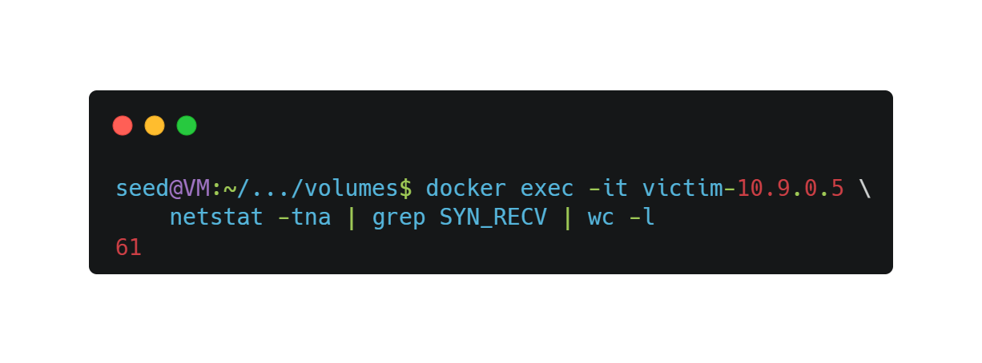
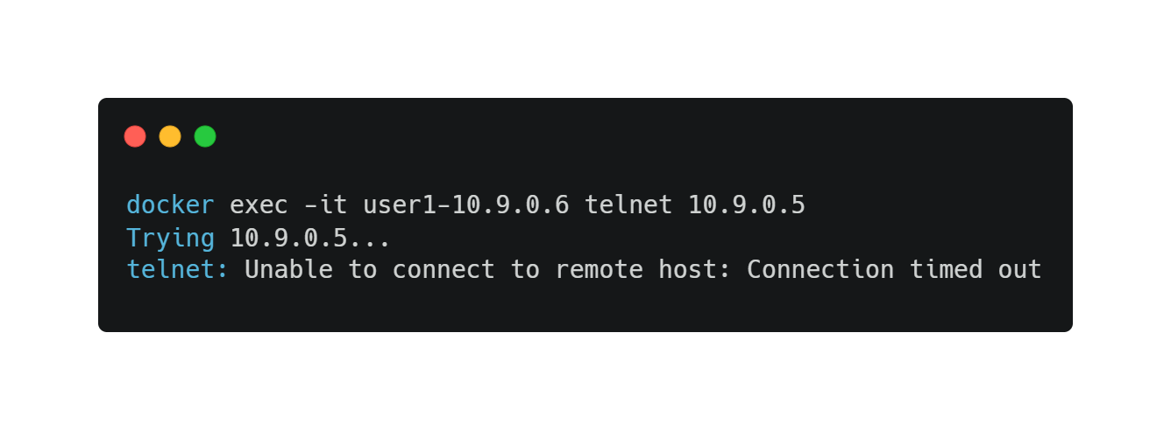
Task 1.1: Smaller backlog
Professional Security Corporation
Backlog reduced to 80, TCP metrics flushed
61 half-open connections observed
1 instance: now Telnet times out
Notes:
CONTENUTO:
Ridotto coda a 80 e resettato Kernel Mitigation
Ora 1 istanza di flooding impedisce connessione con telnet
Coda riempita all'80% (61 posti) e connessione telnet va in timeout (60 sec)

Slide 9
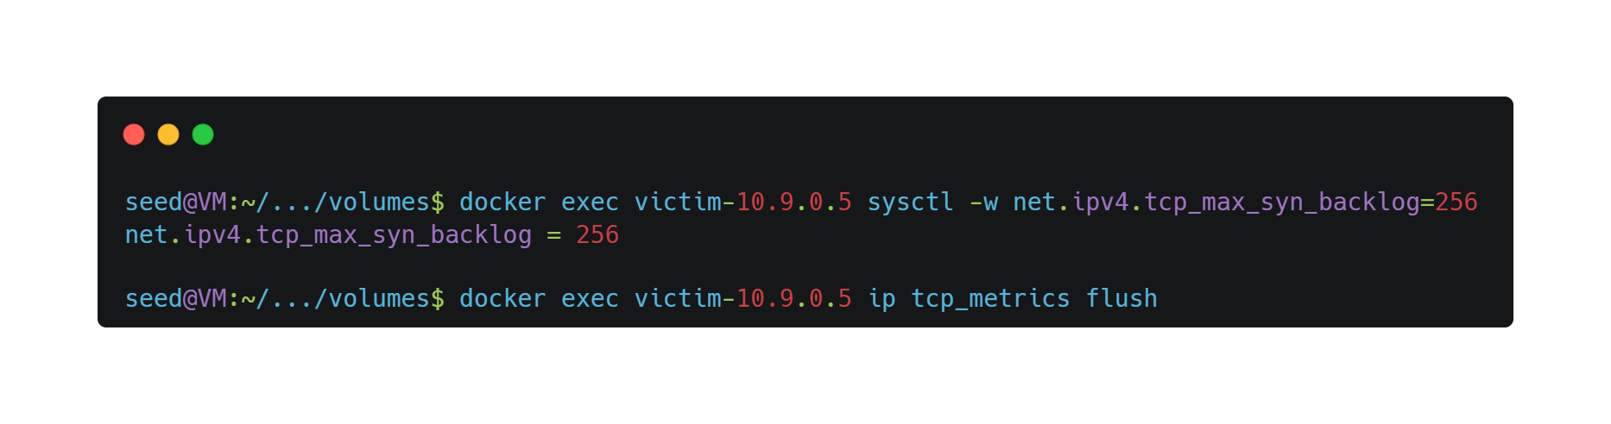
Task 1.2: SYN flood in C
Professional Security Corporation
Backlog restored to 256
C fills queue faster than Python
2+ instances: Telnet blocked
Notes:
CONTENUTO:
Resettato coda a 256 e resettato Kernel Mitigation
File C utilizzato molto più veloce del Python a riempire la coda, MA necessarie almeno 2 istanze attive per impedire connessione telnet
Nonostante indirizzo in "coda destinazioni conosciute", connessione non sempre possibile

Slide 10
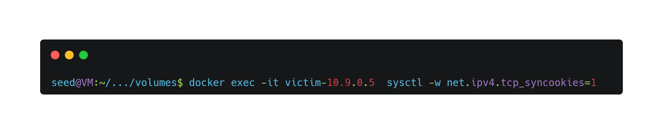
Task 1.3: who wants cookies?
Professional Security Corporation
Restored backlog to 256; flushed TCP metrics
Enabled cookies
Result: Telnet now succeeds during both floods
Known-client cache no longer needed
Notes:
CONTENUTO:
Resettato coda a 256 e resettato Kernel Mitigation
Abilitato SYN cookie
Connessione facile sia con codice Python che con codice C

Slide 11
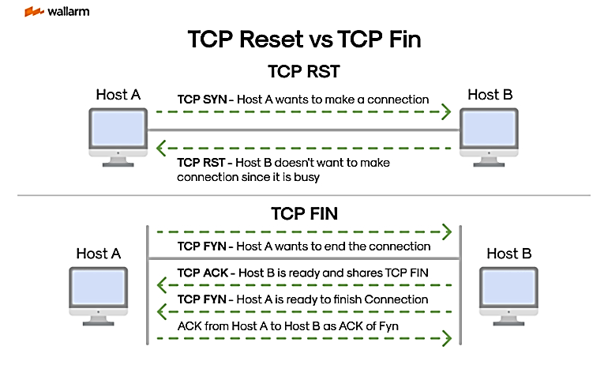
TCP ReSeT
Professional Security Corporation
IMMEDIATE ABORT
Easy to exploit
GRACEFUL SHUTDOWN
Coordinated, boring!
Notes:
TCP provides two different ways to terminate a connection: FIN and RST.
A FIN segment performs a graceful shutdown and requires a coordinated exchange of FIN and ACK messages between both endpoints. This process ensures that all pending data is delivered before the connection is closed.
A RST segment, instead, immediately aborts the connection. Once a valid RST packet is accepted, the receiver discards the connection state without performing the normal FIN/ACK termination procedure.
This behavior is what makes TCP Reset attacks effective. If an attacker can forge a TCP packet containing a valid RST flag and the correct session parameters, the victim will believe the reset originated from the legitimate peer and will immediately terminate the connection.
From an attacker's perspective, a TCP Reset attack is simpler than forcing a normal connection closure because it requires only a single valid RST segment rather than the entire FIN/ACK exchange.
Key takeaway:
FIN requests an orderly termination, while RST forces an immediate termination. A spoofed RST packet can therefore disrupt an active TCP session with a single forged packet.

Slide 12
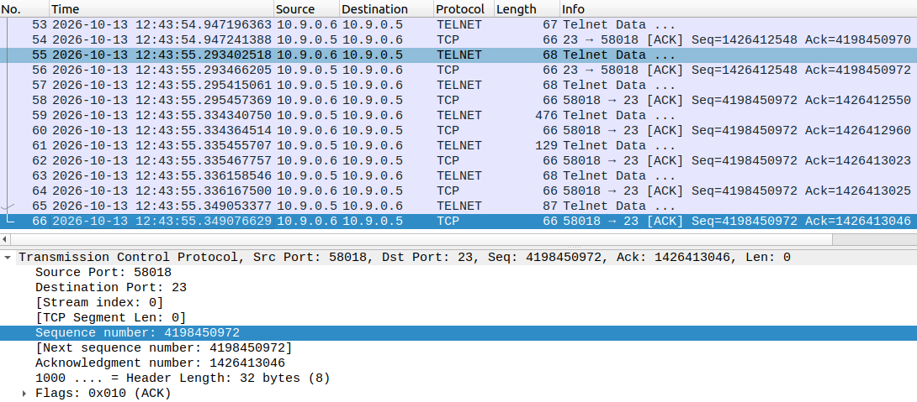
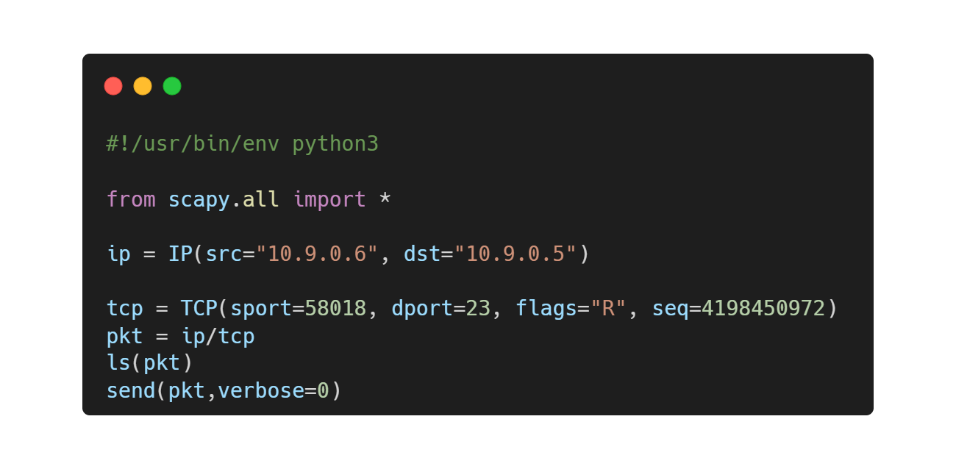
Task 2: RST attack on Telnet
Professional Security Corporation
Let’s mess with their connection with some spoofing (Lab 1)
Telnet login beforehand (avoids timeout and creates some pkts)
Put infos in the script
No feedback, no ACK, no problem!
Notes:
use container user1
make telnet connection+login
see packets
insert in script
note that we dont need ack field

Slide 13
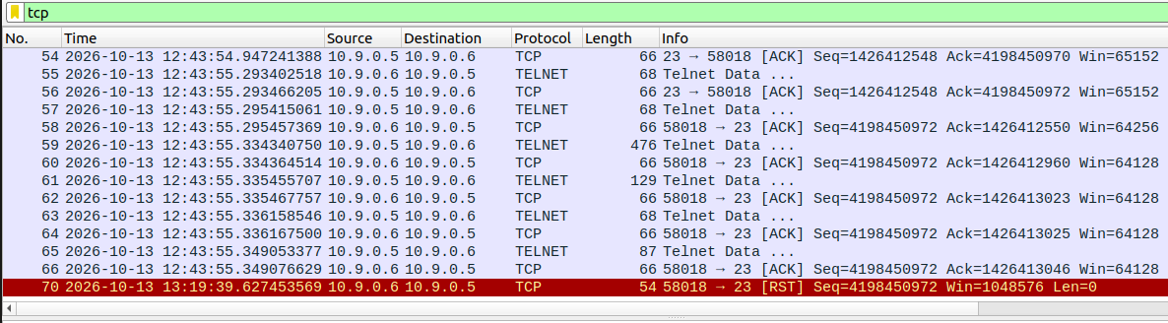
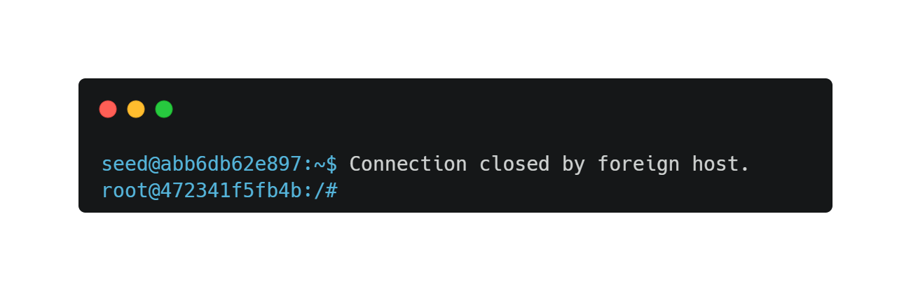
Task 2: RST attack on Telnet
Professional Security Corporation
Connection will close as soon as we run the script

Slide 14
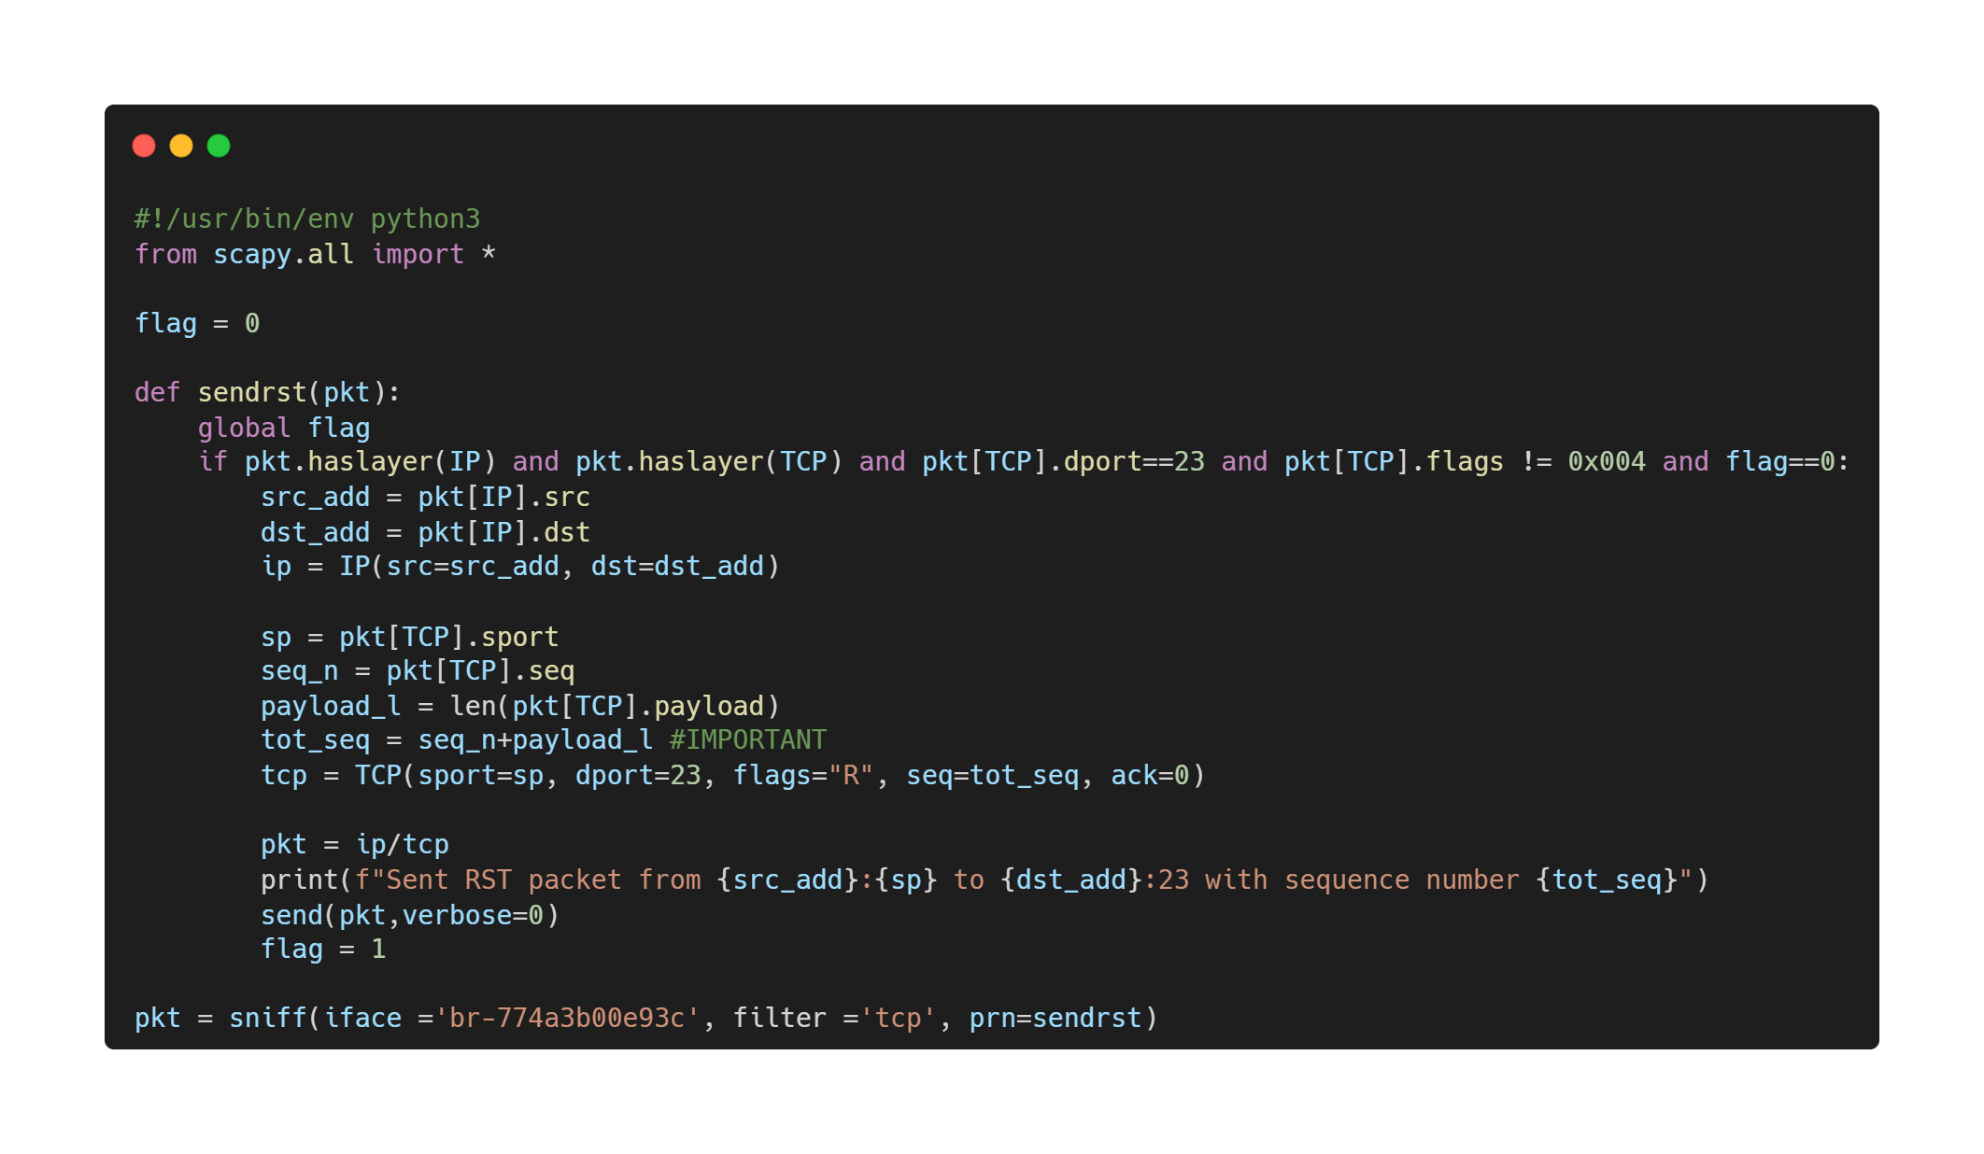
Task 2: RST attack on Telnet
Professional Security Corporation
We can remove the last two conditions inside the if control to be more aggressive and flood the network. Calculate correctly the expected sequence number.
Notes:
- explain tot_seq

Slide 15
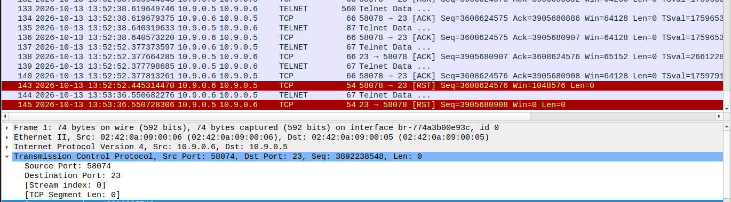
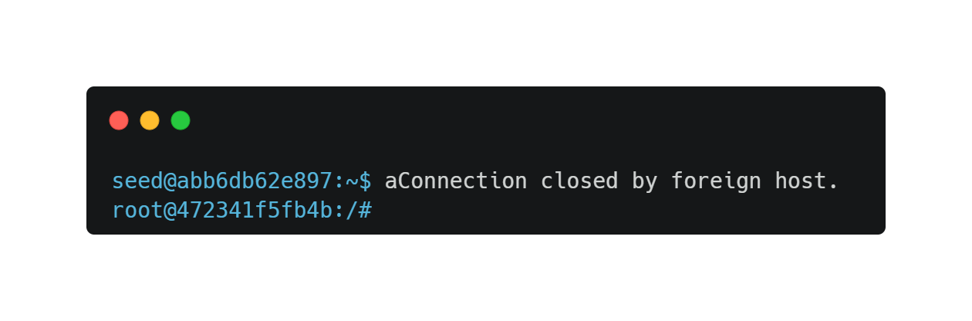
Task 2: RST attack on Telnet
Professional Security Corporation
(any) Telnet packet sniffed → script sends RST
Server receives RST → immediately removes the TCP session state
Legitimate client sends other data → server no longer recognizes the connection → reply RST
Notes:
After receiving the forged RST packet, the server immediately removes the TCP session state. When the legitimate client subsequently sends additional Telnet data, the server no longer recognizes the connection and therefore replies with a TCP RST segment.

Slide 16
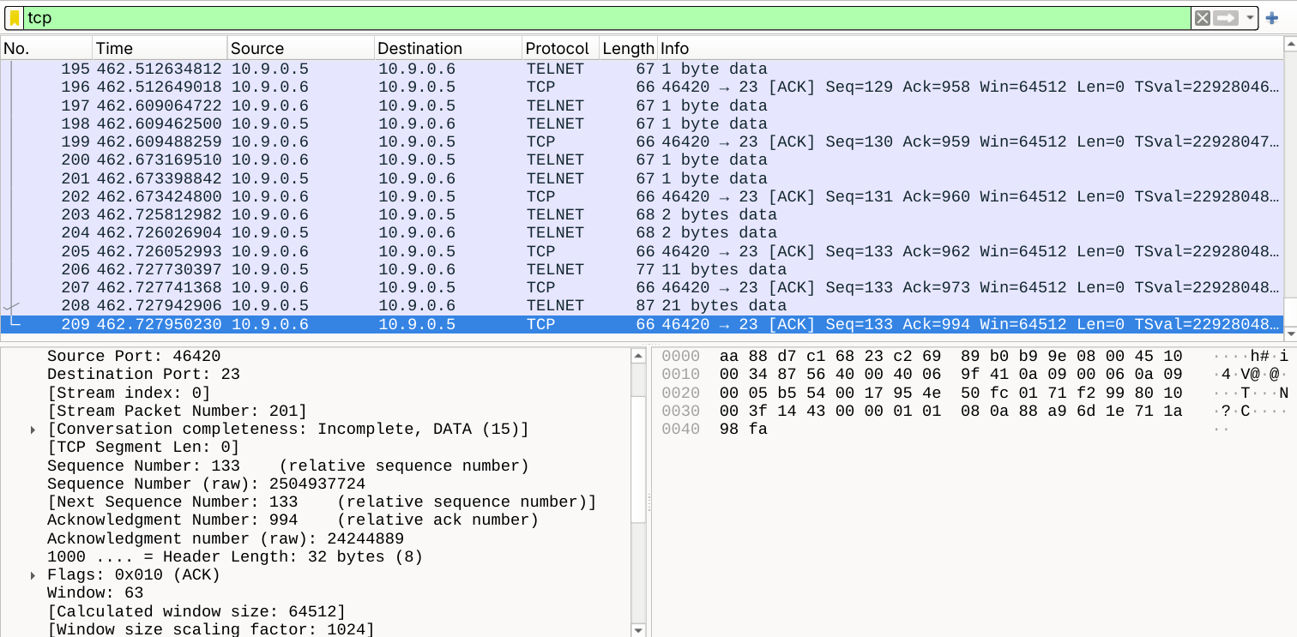
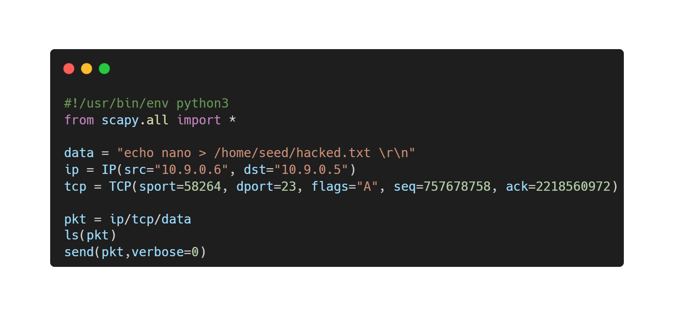
Task 3: Hijacking attack on Telnet
Professional Security Corporation
Capture raw
  SEQ
  ACK
  client port
Next SEQ = last SEQ + payload byte​
Inject command in payload and set correct flags
Notes:
As we did for the Reset, we gather necessary information on Wireshark.
Next Sequence number would be last Seq + payload size (in this case 0) = same Seq.
Edit the provided python file with source port, seq num, ack num, flags and the command placed inside the data field.

Slide 17
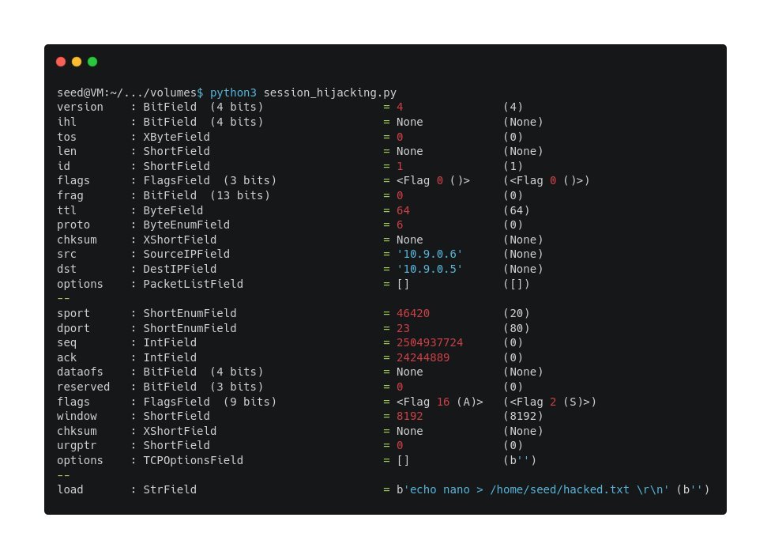
Task 3: Hijacking attack on Telnet
Professional Security Corporation
Notes:
As we send it, the forged packet is then inspected to show the various fields and values that are part of it.
IPs, Seq, Ack, Port and Flags.

Slide 18
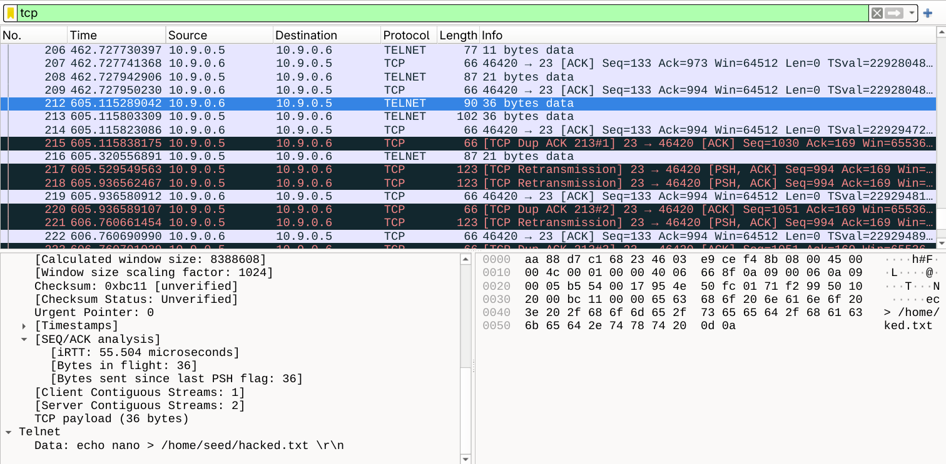
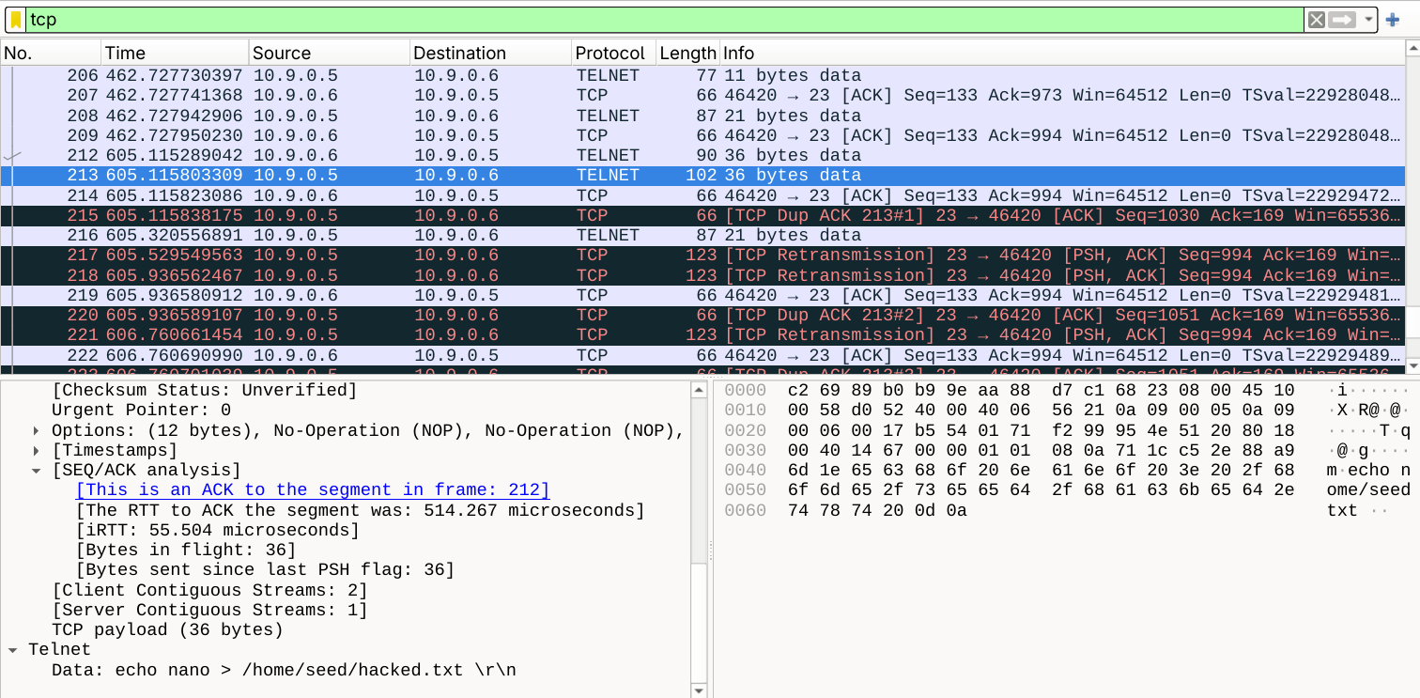
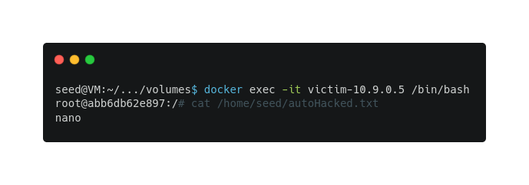

Task 3: Hijacking attack on Telnet
Professional Security Corporation
Sent (Hij)Acked packet
Server respond with ACK, accepting packet
Notes:
Checking on Wireshark.
Packet with correct data and forged payload is sent and the server acknowledge that, accepting the packet as legitimate and executing the code inside.
Connection between legitimate client and server is desynchronized, as shown by continuos sending of TCP Dup(licate) Ack and TCP Retransmission packets.
Results/Effects are verified by logging into the machine and checking for the presence of the file and its content.

Slide 19
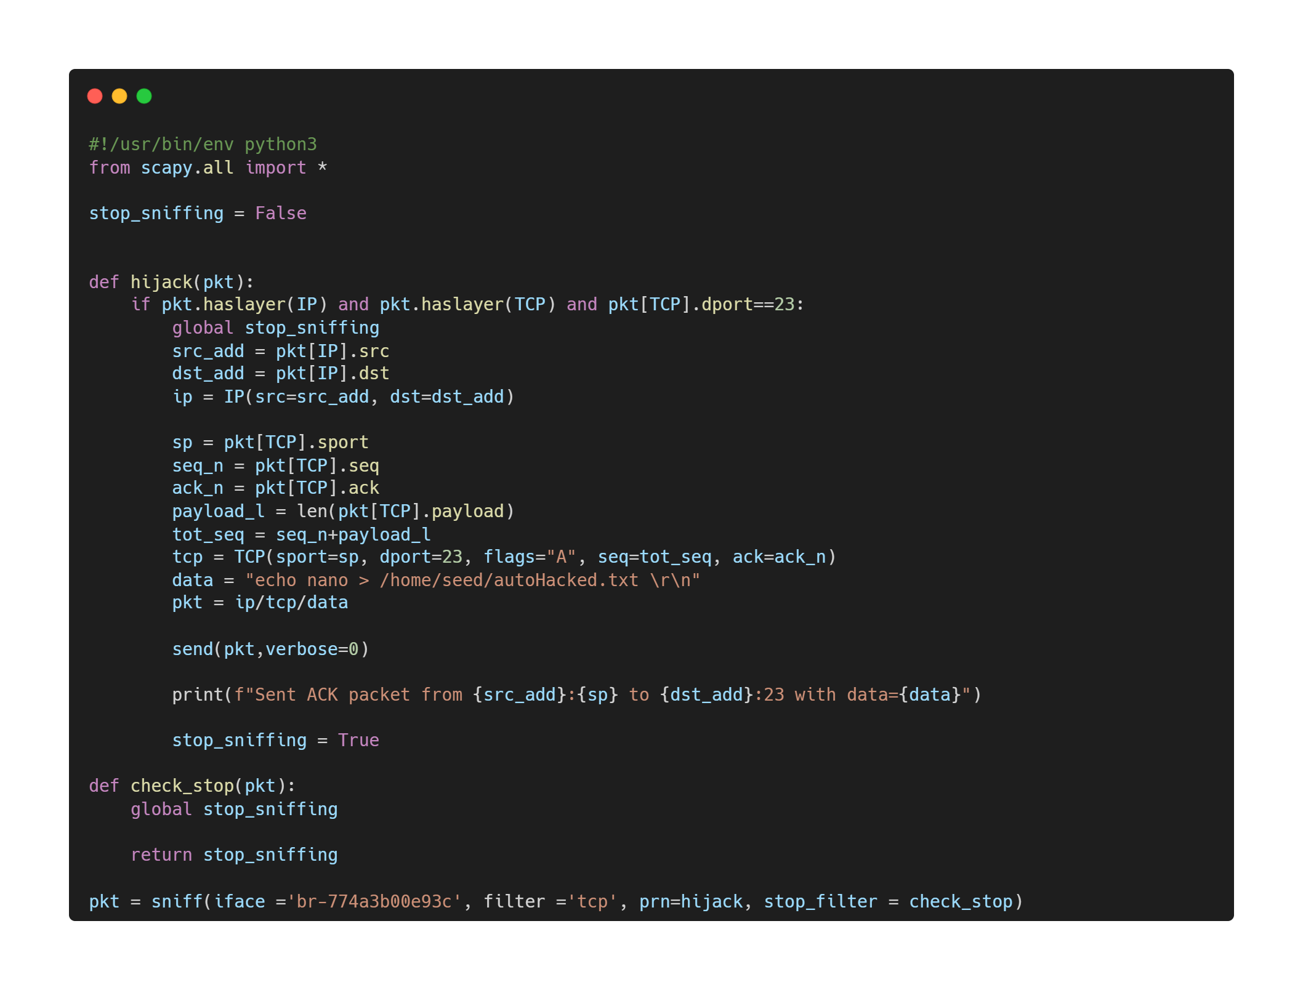
Task 3: Hijacking attack on Telnet
Professional Security Corporation
Automatic retrieving of:
  SEQ
  ACK
  client port
Autonomous send and stop
Notes:
Possible automation of the whole process.
Packet sniffed is analyzed and necessary information are retrieved.
Forged packet is therefore built and sent, and the sniffer is then stopped.

Slide 20
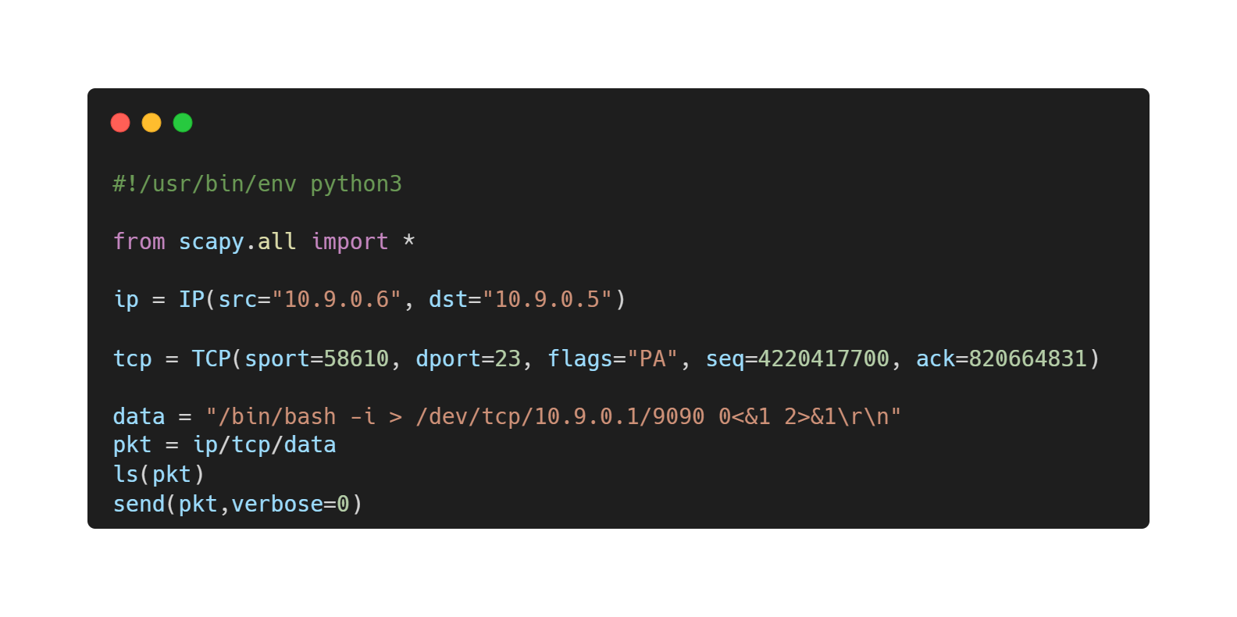
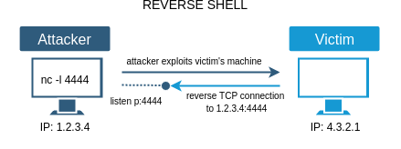
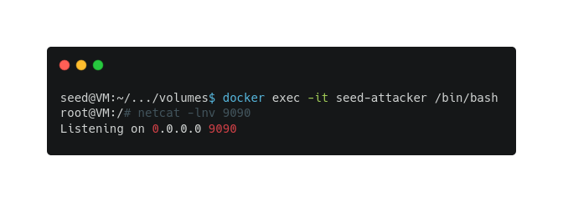
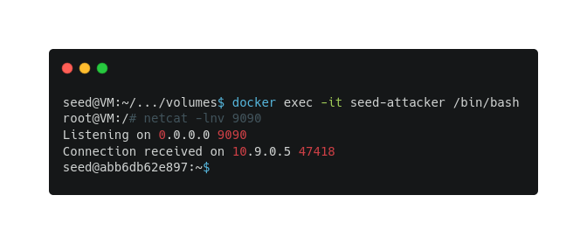
Task 4: Reverse shell
Professional Security Corporation
Specific payload with command
Opening ports to accept inbound connection
Successfully connected to a Reverse Shell

Slide 21
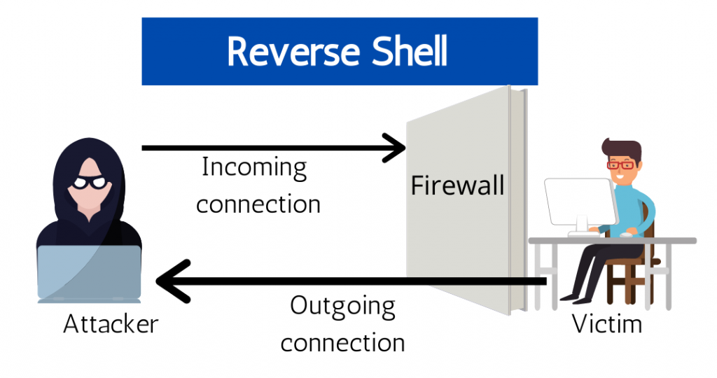
Task 4: Reverse shell
Professional Security Corporation
Specific payload with command
Opening ports to accept inbound connection
Successfully connected to a Reverse Shell

Slide 22

Professional Security Corporation
Thanks for your attention!
Any questions?
The fun continues here:
github.com/ProSecCorp

